Slide 1
Models for Understanding and Controlling Global Infectious Diseases HUMBIO 154D / HRP 204
Session 11
Jason Andrews
Jeremy Goldhaber-Fiebert
2020

Slide 2
Course Roadmap
First Models
SIR models with demography
Reproductive Number, Thresholds, Equilibria
Lab: Dynamic Models in R
Heterogeneous mixing and temporal modeling
Emerging infections: takeoff, growth, extinction
Lab: Emerging infections
Vectors, zoonoses, & environmental transmission
Stochastic dynamics
Spatial models, networks
Interventions and sensitivity analyses
Lab: Interventions and sensitivity analyses
Competition and evolutionary models
Within host evolution
Lab on Parameterization, calibration, and uncertainty
Health policy and economic evaluation models
Uses and abuses of models

Slide 3
Practical Questions
How do we explore how sensitive our model outcomes, projections, and assessments of preferred interventions are to alternative reasonable assumptions?
How do we introduce a range of common interventions into our infectious disease models? What needs to change? What assumptions are needed?

Slide 4
Learning Objectives
Define sensitivity analysis
Differentiate sensitivity analysis from uncertainty analysis
Explain what our model parameters represent
Appreciate computational requirements of n-way sensitivity analyses
List a range of interventions relevant for infectious disease models
Define the types of parameter and structural changes and additions needed for interventions like vaccination
Explain the vaccine critical threshold and herd immunity
Relate vaccination to social/physical distancing
Describe a model for quarantine/isolation
Discuss case identification rate in relation to test sensitivity and specificity
Describe community quarantine/isolation and compare/contrast it with individual-level quarantine/isolation
Describe contact tracing

Slide 5
What is a sensitivity Analysis?

Slide 6
Sensitivity Analysis: Definition #1
A set of computations that examines how systematic changes in a model’s structure and/or parameters alter the conclusion of the analysis

Slide 7
Example: An analysis might examine the prevalence of a disease over time
# Infectious
Time

Slide 8
Example: If we change one of the parameters (e.g., gamma), how does the prevalence curve change?
# Infectious
Time

Slide 9
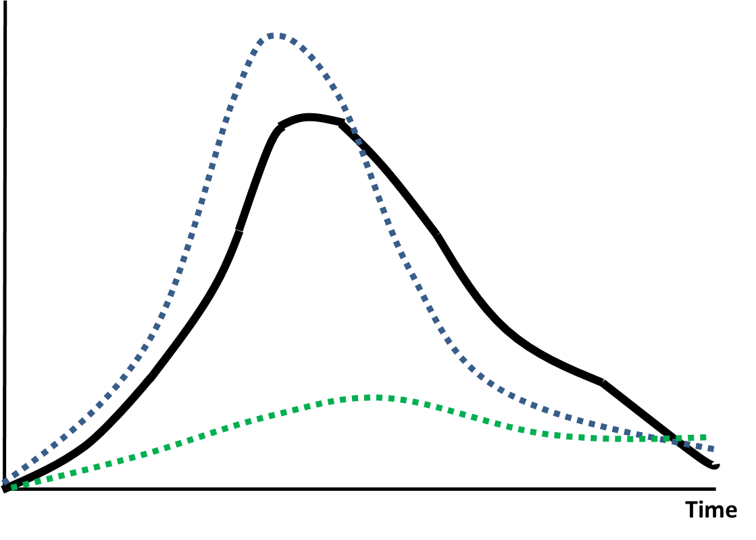
Example: To simplify things for teaching today, we could focus on a single numeric quantity and how it changes with different values of gamma
γ = 1/15 days
46 infection-years
# Infectious
γ = 1/20 days
68 infection-years
γ = 1/10 days
12 infection-years
Time

Slide 10
Sensitivity Analysis and Interventions
The second half of today’s lecture is about interventions, which means, at minimum, we are interested in a model’s predicted outcomes with and without intervention
This is often connected to deciding making: choosing the intervention that we expect to provide us with the most of a good outcome or the least of a bad outcome
Examples: minimizing infections/year; maximizing life expectancy
We can refine our sensitivity analysis definition accordingly

Slide 11
Sensitivity Analysis: Definition #2
A set of computations that examines how systematic changes in a model’s structure and/or parameters alter outcomes under alternative interventions and whether such changes are sufficient to change our preferred intervention and hence the conclusion of the decision analysis (e.g., cost-effectiveness analysis, cost-benefit analysis, etc.)

Slide 12
Types of sensitivity analyses
Threshold analysis
One-way sensitivity analysis (OWSA)
Multi-way sensitivity analysis (MWSA)
Probabilistic sensitivity analysis (PSA)

Slide 13
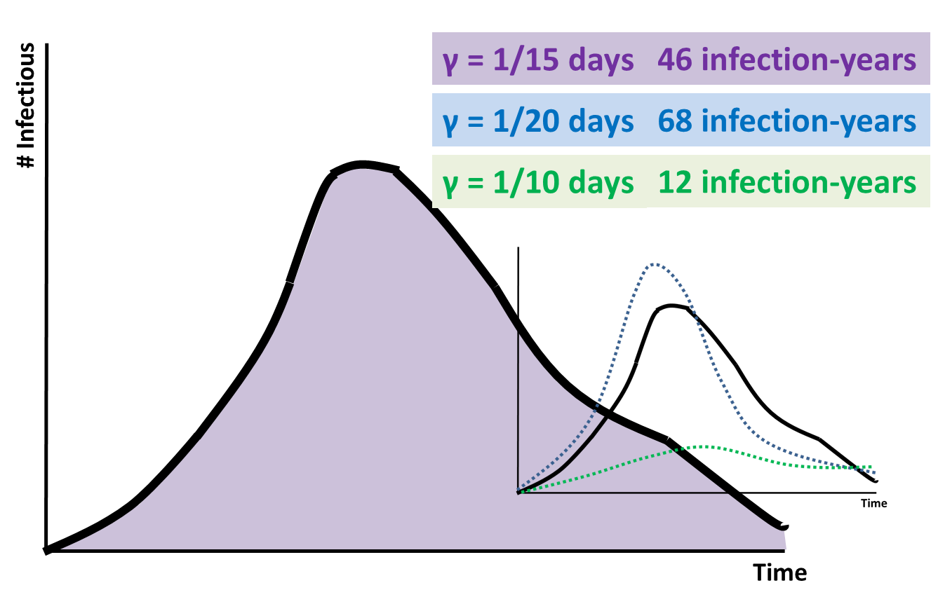
Simple threshold analysis
Intervention
Infection-years
No intervention
γ
Where is the threshold?

Slide 14
Simple threshold analysis
Intervention
Infection-years
No intervention
1/20
1/15
1/10
γ
Is the decision sensitive to γ?

Slide 15
Simple threshold analysis
Intervention
Infection-years
No intervention
1/25
1/20
1/15
1/10
γ
Is the decision sensitive to γ?

Slide 16
Simple threshold analysis
Intervention
Infection-years
No intervention
1/25
1/20
1/15
1/10
γ
We can think about the decision in terms of the net difference in outcome between Intervention and No Intervention

Slide 17
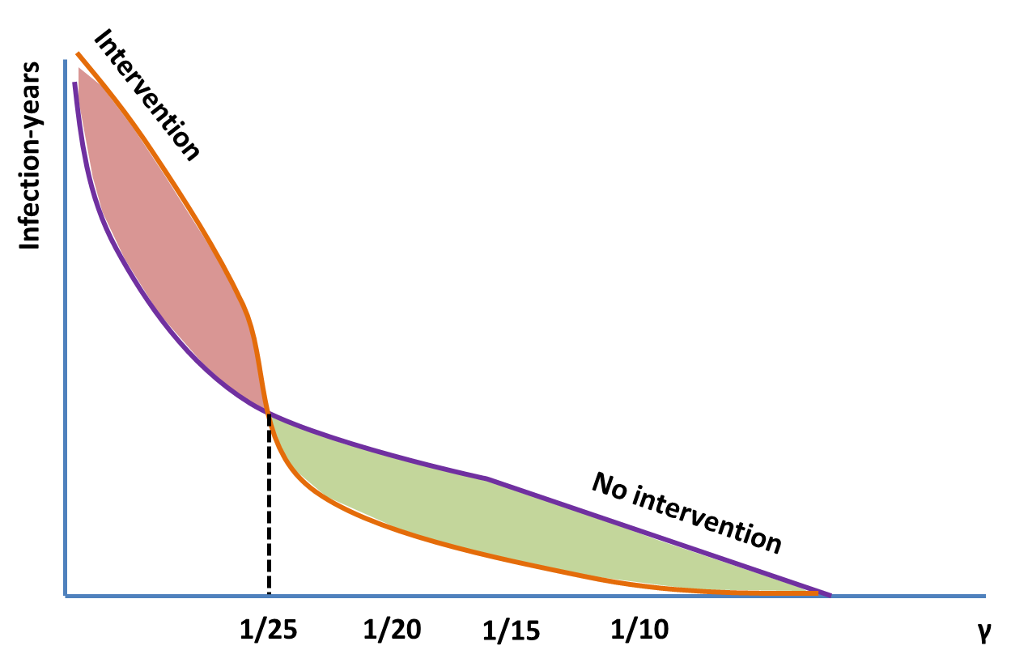
Simple threshold analysis
Prefer
Intervention
Net difference in
Infection-years
γ
Prefer
No Intervention
1/25

Slide 18
Extension to one-way sensitivity analysis
Prefer
Intervention
Net difference in
Infection-years
γ
Prefer
No Intervention
1/25
For an OWSA, we define a plausible range of one of our parameters and examine how the outcomes change and whether our decision would change

Slide 19
Extension to 2-way sensitivity analysis
β
γ

Slide 20
Extension to 2-way sensitivity analysis
β
γ

Slide 21
Extension to 2-way sensitivity analysis
β
γ

Slide 22
Extension to 2-way sensitivity analysis
β
Intervention
preferred
No Intervention
preferred
γ

Slide 23
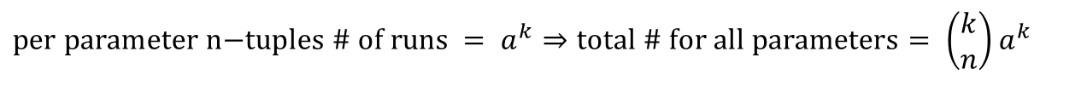
How many model runs?
Model with n total parameters
MWSA with k parameters (e.g., k=2 for {β,γ})
Assume we want to explore the k parameters across a range with a min and max
Denote # of levels of each parameter explored as “a”
When a parameter is not in k, we hold it at its mean value
Doing MWSA for lots of different parameters is computationally intensive
$$\text{per} \text{parameter} \text{n}\text{−}\text{tuples}\text{ \# }\text{of} \text{runs} = a^{k}⇒\text{total}\text{ \# }\text{for} \text{all} \text{parameters}= \left(\begin{matrix}k \\ n\end{matrix}\right)a^{k}$$

Slide 24
Moment of reflection
What do the parameters in our models represent?
They are population means (e.g., average rate of recovery for people with a given infection) (How to measure this?)
What is a sensitivity analysis doing?
It asks: Across a range of plausible population mean values of our parameters, would our conclusions change?
What it does not ask:
How does individual variation from the mean impact our conclusions? (How would we do this?)
How uncertain are we about our conclusions give our uncertainty in the population means? (how uncertain are we about those means?)
For uncertainty analyses: We need probabilistic sensitivity analysis (PSA) (see calibration lecture)

Slide 25
HOW DO WE MODEL INTERVENTIONS?

Slide 26
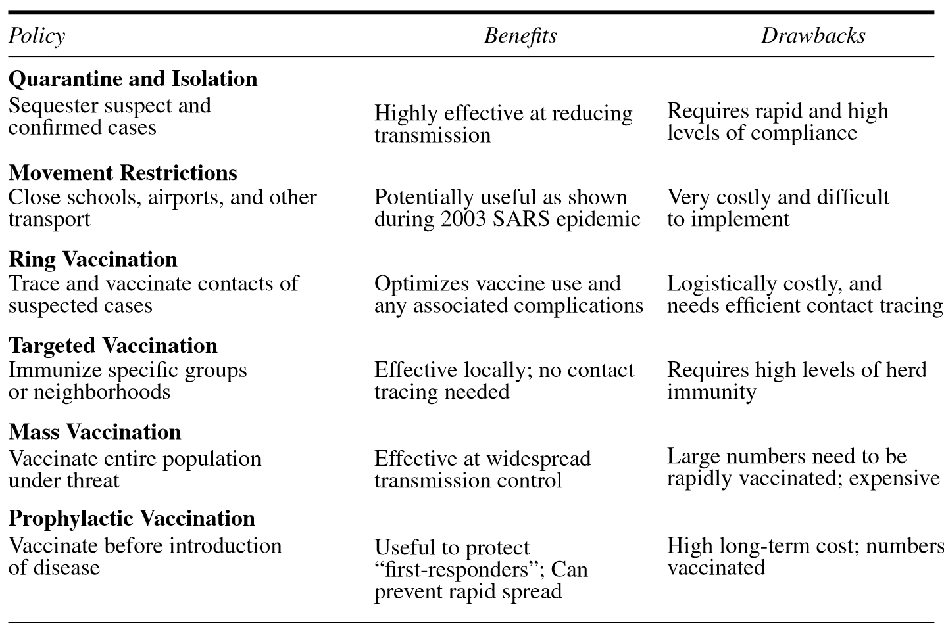
Types of Interventions
Prophylactic Treatment; Screening and Treatment; Elimination of Zoonoses;
Clean-up of environmental reservoirs; Social/Physical Distancing; Combinations of strategies

Slide 27
How do we map interventions into our models?
All interventions will require
Either changes to values of parameter(s)
Or changes to model structure(s)
Or changes to both parameter(s) and structure(s)

Slide 28
Let’s start with our SIR model with demography
S
βI
I
γ
R
b
µ
µ
µ

Slide 29
Pediatric vaccination: at birth (or right after maternal immunity wanes), a proportion (p) of babies are successfully vaccinated
S
βI
I
γ
R
b
µ
µ
µ
p = proportion successfully vaccinated; Why do we say “successfully”?
What are the minimum two steps needed for “success”?
Fraction given the vaccine * Fraction that achieve a sufficient immune response conditional on being vaccinated
How does p enter into our model?

Slide 30
Pediatric vaccination: at birth (or right after maternal immunity wanes), a proportion (p) of babies are successfully vaccinated
(p)b
S
βI
I
γ
R
(1-p)b
µ
µ
µ
We assume that naturally acquired immunity is like vaccine acquired immunity
Therefore we split the births between susceptibles (those not vaccinated) and the recovereds (those vaccinated)
We also assume the program operates on a continuous constant level

Slide 31
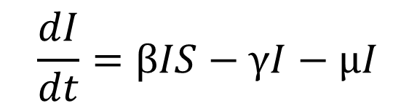
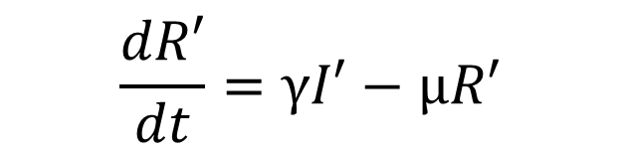
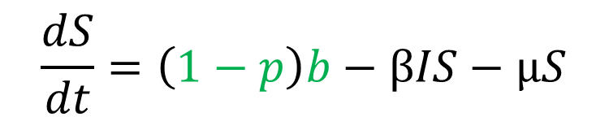
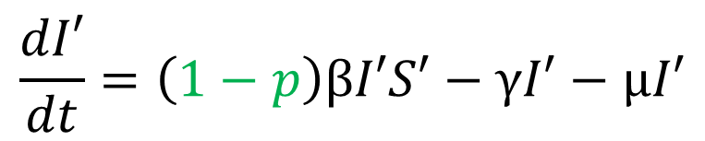
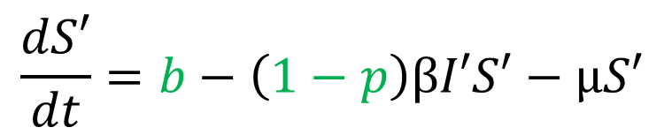
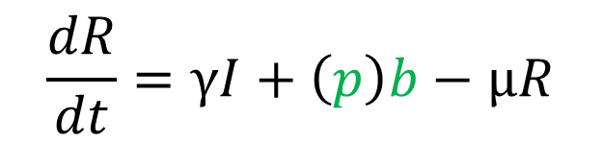
Pediatric vaccination: at birth (or right after maternal immunity wanes), a proportion (p) of babies are successfully vaccinated
$$\frac{dS}{dt}=\left(1−p\right)b−βIS−μS$$
$$\frac{dS′}{dt}=b−\left(1−p\right)βI′S′−μS′$$
$$\frac{dI}{dt}=βIS−γI−μI$$
$$\frac{dI′}{dt}=\left(1−p\right)βI′S′−γI′−μI′$$
$$\frac{dR}{dt}=γI+\left(p\right)b−μR$$
$$\frac{dR′}{dt}=γI′−μR′$$
Keeling and Rohani show that the system on the left is equivalent to the one on the right
The key insight of the one of the right is that the effective reproductive number with vaccination is
(1-p)*R₀ => p_{c} must be at least 1- 1/R₀ to achieve eradication

Slide 32
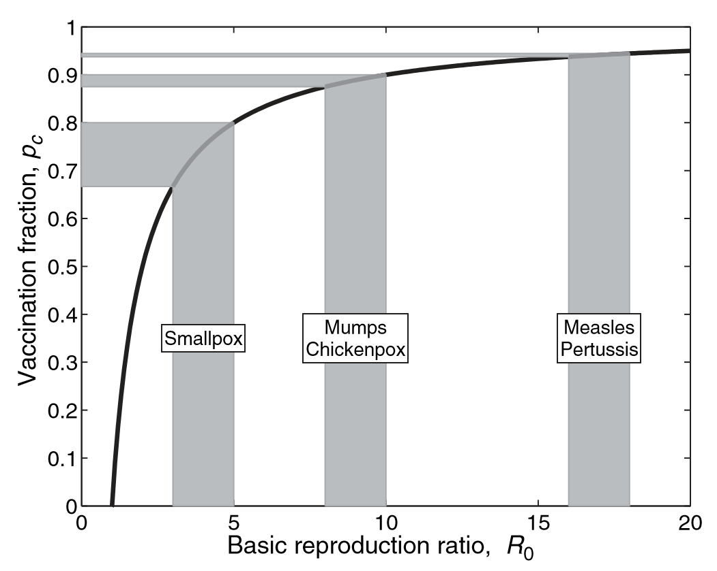
Critical vaccination proportions required for various infectious diseases
Why is there a range of R0s for each disease?
If we know that R0 = Beta/(Mu+Gamma), how is this range related to a form of sensitivity analysis?

Slide 33
Critical vaccination proportions required for various infectious diseases
Why is there a range of R0s for each disease?
If we know that R0 = Beta/(Mu+Gamma), how is this range related to a form of sensitivity analysis?
In order to eradicate a disease with infant vaccination, a portion of the population can remain unvaccinated but protected via “herd immunity”

Slide 34
When we achieve pc, how long does it take for prevalence of I to reach 0? Even if pc is not achieved, what happens to prevalence of I?

Slide 35
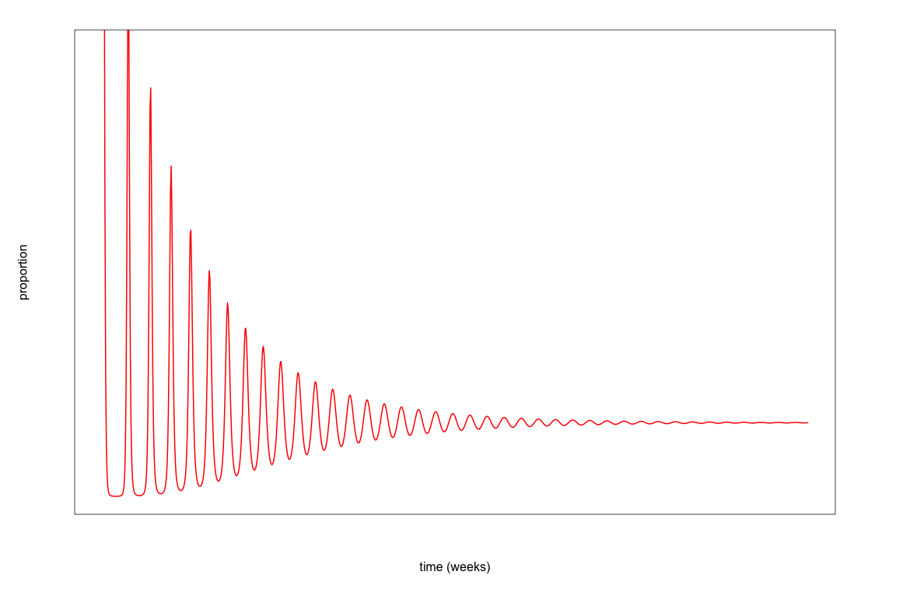
Vaccination Effects: We start vaccination at the dashed black line (>p_{c} [purple]; <p_{c} [blue])
When p >> pc, eradication happens faster

Slide 36
Vaccination in an SIR model
S
βI
I
γ
R
V
u
Keeling and Rohani call this “Wildlife Vaccination” but really this is just a model in which a vaccination rate is applied to the susceptibles who enter a vaccinated compartment
First model where we change the structure
Why is there no rate of flow from I’s or R’s? How do we know whom to vaccinate?

Slide 37
Vaccination in an SIR model
ω
S
βI
I
γ
R
V
u
Keeling and Rohani call this “Wildlife Vaccination” but really this is just a model in which a vaccination rate is applied to the susceptibles who enter a vaccinated compartment
The structural change allows for things like waning vaccine-induced immunity even if natural immunity does not wane (e.g., Zoster)

Slide 38
Types of Interventions: Many variants of vaccination which are treated in Keeling and Rohani
Prophylactic Treatment; Screening and Treatment; Elimination of Zoonoses;
Clean-up of environmental reservoirs; Social/Physical Distancing; Combinations of strategies

Slide 39
How would we model Social/Physical Distancing? What should change and why?
S
βI
I
γ
R
b
µ
µ
µ

Slide 40
How would we model Social/Physical Distancing? What should change and why?
S
(1-p)βI
I
γ
R
b
µ
µ
µ
Social/physical distancing reduces the number of contacts we have per unit time and may also change the probability of transmission given a contact if it is accompanied by other hygiene changes (e.g., handwashing, masks) depending on how we define contact
When there are no contacts at all, there is no transmission

Slide 41
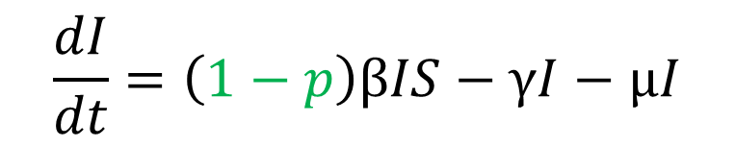
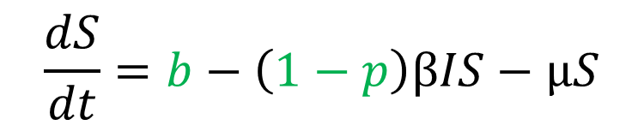
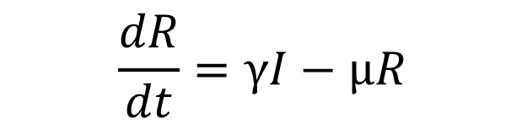
Such an approach to Social/Physical Distancing looks like our model of infant vaccination
$$\frac{dS}{dt}=b−\left(1−p\right)βIS−μS$$
$$\frac{dI}{dt}=\left(1−p\right)βIS−γI−μI$$
$$\frac{dR}{dt}=γI−μR$$
Again, the key insight of the one of the right is that the effective reproductive number with social distancing is
(1-p)*R₀ => p_{c} must be at least 1- 1/R₀ to achieve eradication

Slide 42
Isolation/Quarantine in an SIR model with demography
µ
d_{I}
S
βI
I
γ
R
τ
Q
µ
µ
µ
µ
Again, we add a new state (Q) which is the quarantine state
Infectious individuals who are detected enter the state at a rate d_{I}
Individuals leave quarantine at a rate tau after they have recovered
The critical rate of detection = beta – gamma – mu (to get reproductive number below 1); The rate means that both the fraction & timing matter
Keeling and Rohani do not have mu leaving quarantine presumably because it is small relative to tau (but I include it here)

Slide 43
Isolation/Quarantine in an SIR model with demography
µ
d_{I}
S
βI
I
γ
R
τ
Q
µ
µ
µ
µ
Let’s think a bit more about what d_{I} means
How does detection occur?
For a disease like measles?
For a disease like COVID-19? What about asymptomatic infectious individuals?
How does testing play in to d_{I}?

Slide 44
Testing and test results (at a given cutoff)
 | Disease+ | Disease- | Totals
Test+ | a | b | a+b
Test- | c | d | c+d
Totals | a+c | b+d | a+b+c+d=n
a = # with disease who test positive
b = # without disease who test positive
c = # with disease who test negative
d = # without disease who test negative

Slide 45
Testing and test results (at a given cutoff)
 | Disease+ | Disease- | Totals
Test+ | a | b | a+b
Test- | c | d | c+d
Totals | a+c | b+d | a+b+c+d=n
What is the probability of people with the
disease testing positive?
Sensitivity = a/(a+c) = True Positive Fraction (TPF)
With equal effort but a less sensitive test, d_{I} will be lower => harder for quarantine to achieve eradication

Slide 46
Testing and test results (at a given cutoff)
 | Disease+ | Disease- | Totals
Test+ | a | b | a+b
Test- | c | d | c+d
Totals | a+c | b+d | a+b+c+d=n
What is the probability of people without the
disease testing negative?
Specificity = d/(b+d) = 1-False Positive Fraction
Since specificity deals with test results for people who do not have disease (not I’s), it will not directly impact the effect of quarantine, but lower specificity could fill up quarantine capacity and add substantial costs (more false positives)

Slide 47
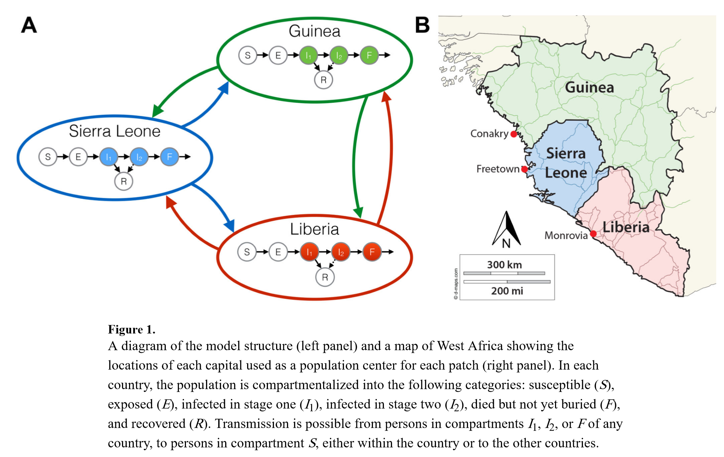
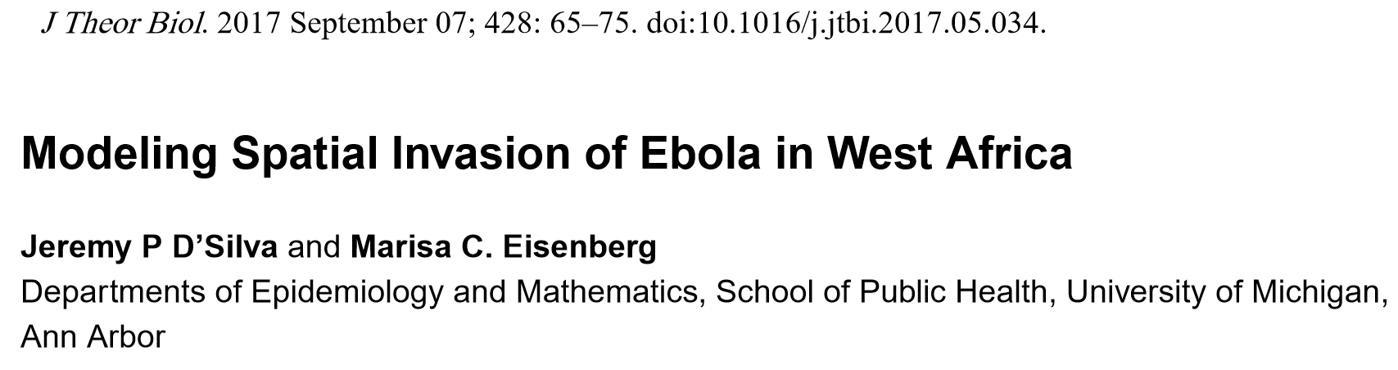
Community Quarantine (movement restriction) in conjunction with other interventions

Slide 48
Contact Tracing
τ_{T}
S
βI
I
d_{I}
T
cb
Contact Tracing in a sexually transmitted infection model (SI[S])
STI treatment + listing out recent sexual partners
Partners are contacted, tested, and if infected, treated and their partners contacted in turn
1/τ_{T}=avg time in treatment; d_{I}=rate of treatment seeking; c=rate of contact tracing; b=probability that traced individual is infectious (I,1)
Contact tracing needs to happen at a rate that is faster than the growth rate (related to R0 of the disease) in order to eradicate the disease

Slide 49
Important Announcements

